Slide 1

LIBRARY MANAGEMENT SYSTEM
Team Members:
Rajeswari Jayachandran
Kalai Arasi Jayakumar
Sai Harsha Chapala
Amrutha Reddy Karumuru
Sai Adhithi Kesari

Slide 2

Project Goal
The project's objective is to create a productive book lending system that is supplemented with a potent search engine and insights driven by machine learning to recognize patterns like the best-selling books. In addition to managing loans and returns, updating databases with new titles, and giving information on library staff and checked out books, the proposed system will benefit both users and administrators.

Slide 3
Project Overview
The Library Management System is a feature-rich book management platform that offers secure admin and user logins, book searching, management, analysis, and feedback gathering all from an intuitive menu. It makes use of the Book Finder module's Google Books API to provide in-depth searches by book title or author. Additionally, advanced book dataset analysis with a variety of interactive visualizations is provided by the platform. A feedback mechanism also enhances user engagement and facilitates system improvement by enabling users to contribute and preserve their impressions.

Slide 4

Functionalities and Tech stack
Google book finder enabling detailed searches by book title or author.
Book Manager to borrow/return books.
Catalogue to search for the books that are currently available in the library system.
Feedback page enhancing user engagement and system improvement.
Tech Stack :
Language :Python
Front-end: Streamlit
Backend : Flask,SQL

Slide 5
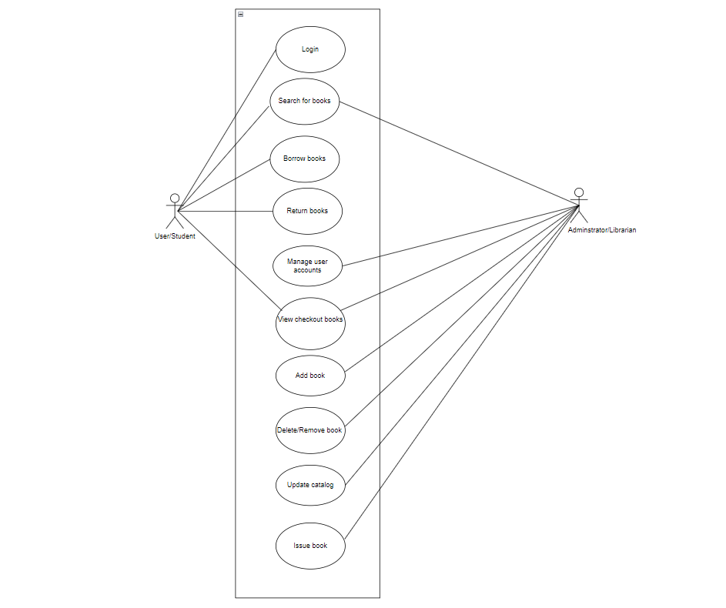
Use case diagram

Slide 6
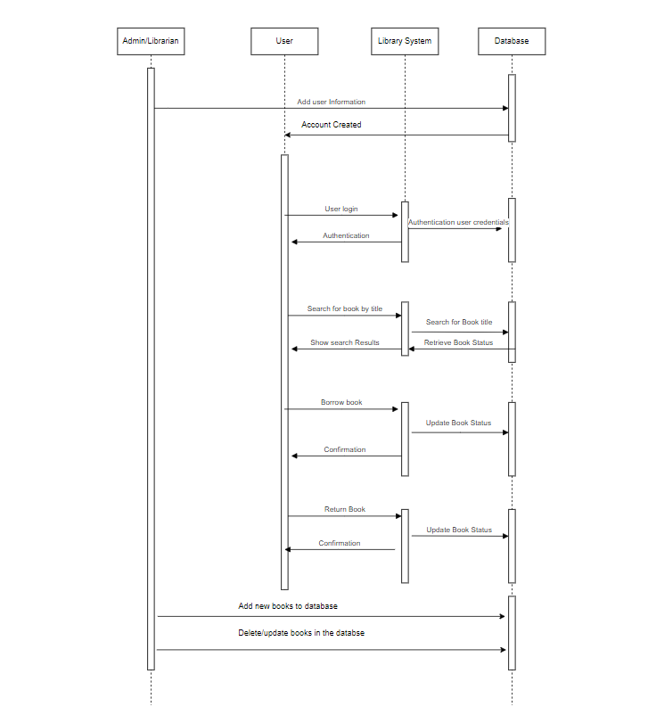
Sequence diagram

Slide 7
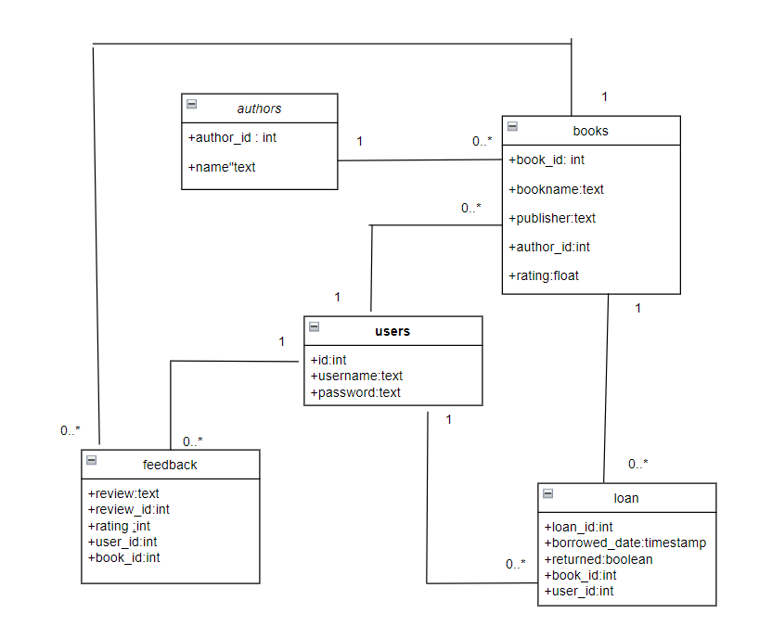
Class diagram

Slide 8
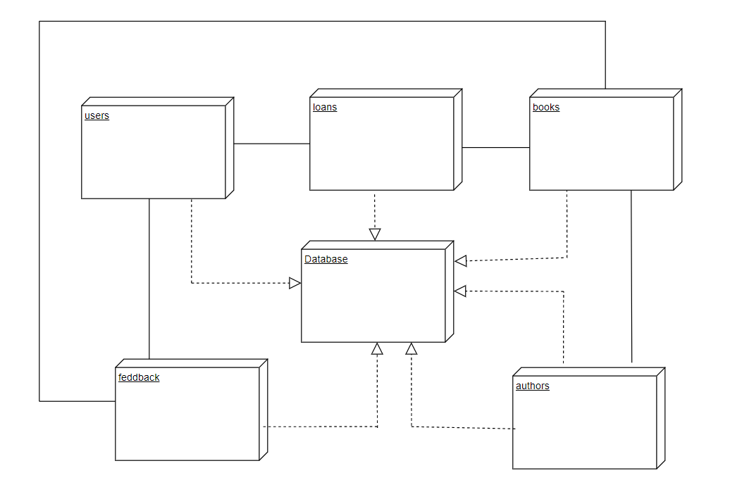
Deployment diagram

Slide 9
Future scope
Creating a mobile application or enhancing web accessibility to guarantee seamless access to the platform across a variety of devices.
Data analysis on the books feedback.
Personalized book recommendations based on user behavior and preferences.

Slide 10
Thank you

